Slide 1
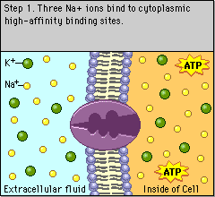
Pumps require energy, channels do not
This is an electrogenic pump.

